Slide 1

Guns & Games
Gun Violence & Video Game Sales in America
Gaston Alvarado · Jeremy Halek · Yevgeniy Khmelnitskiy · Robert Rua · Anthony Uhuegbue

Slide 2
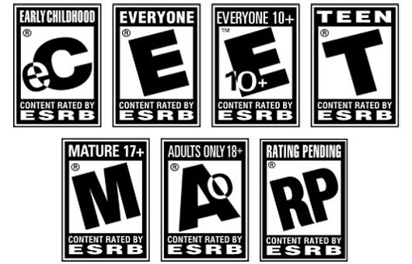
THEME
Our goal for this project is to understand whether or not there are possible relationships between gun violence and sales of violent video games in the United States. We hypothesize that as sales and players of violent video games are increasing, so too is gun violence.

Slide 3
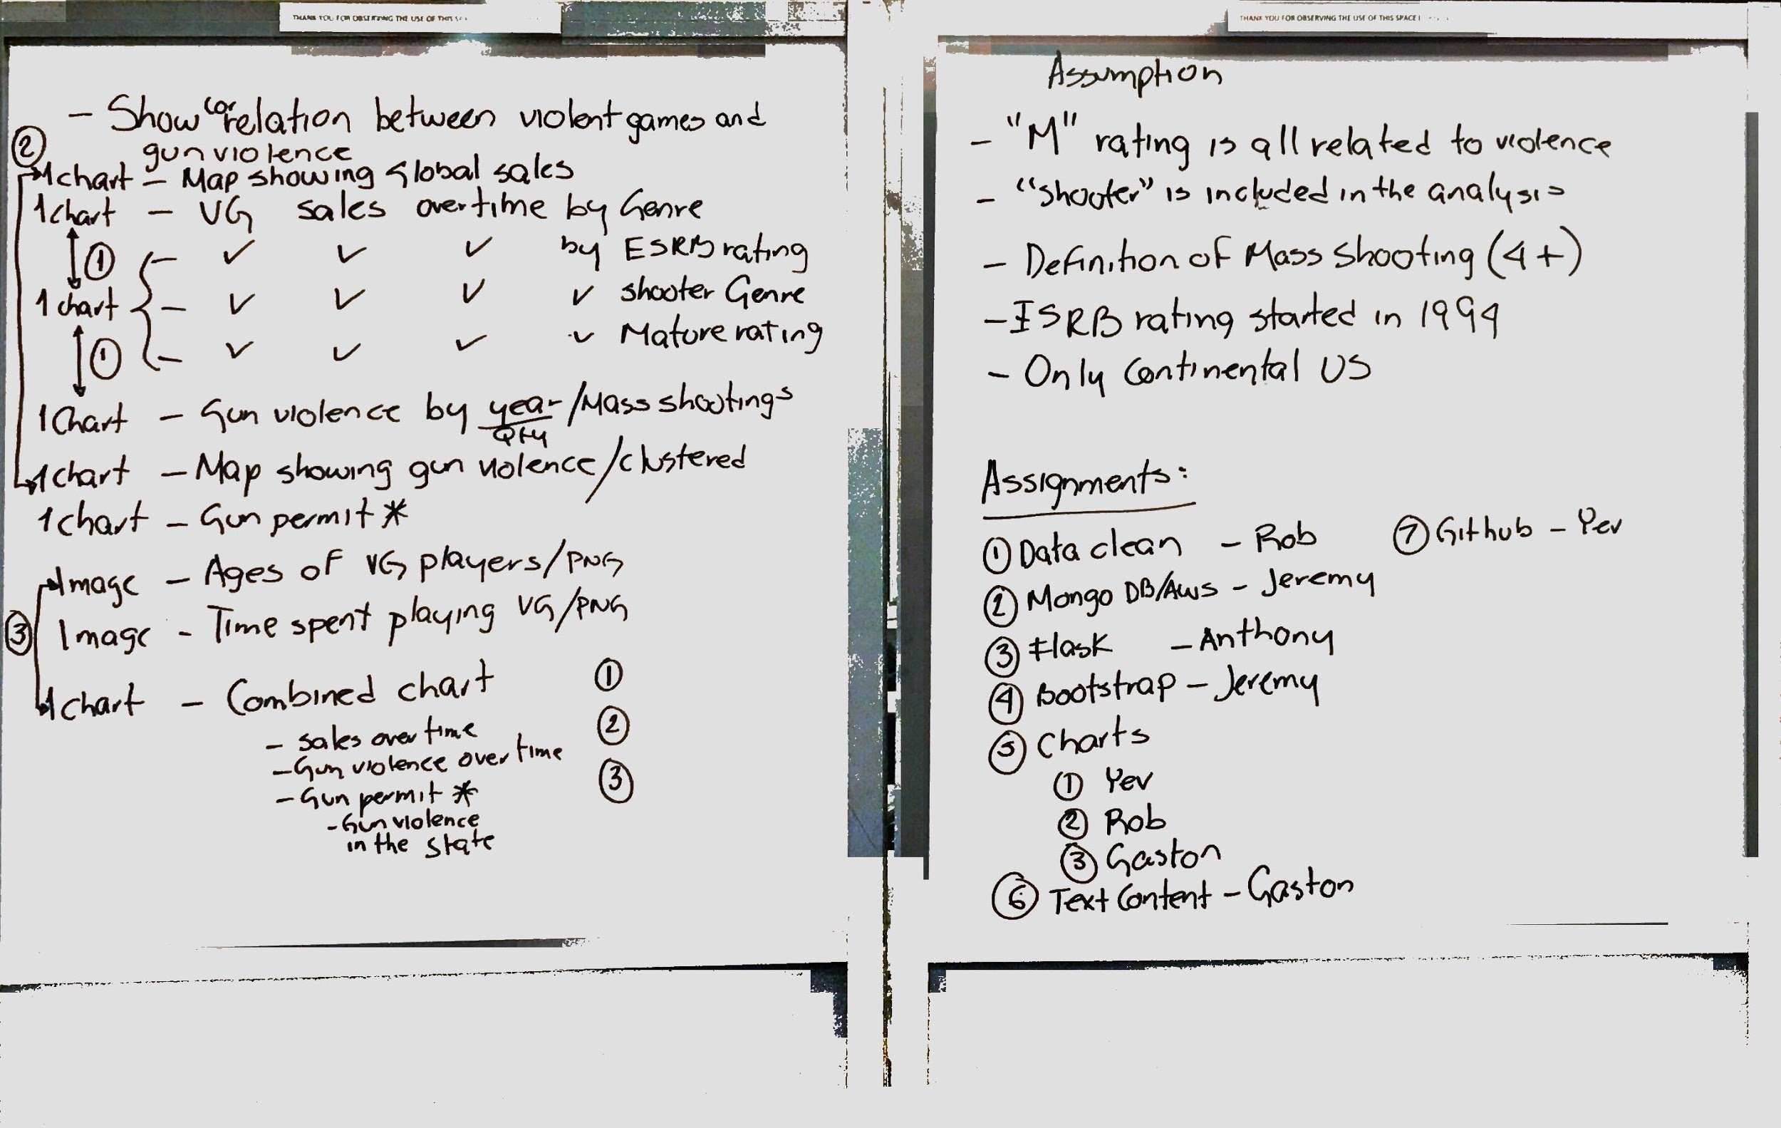
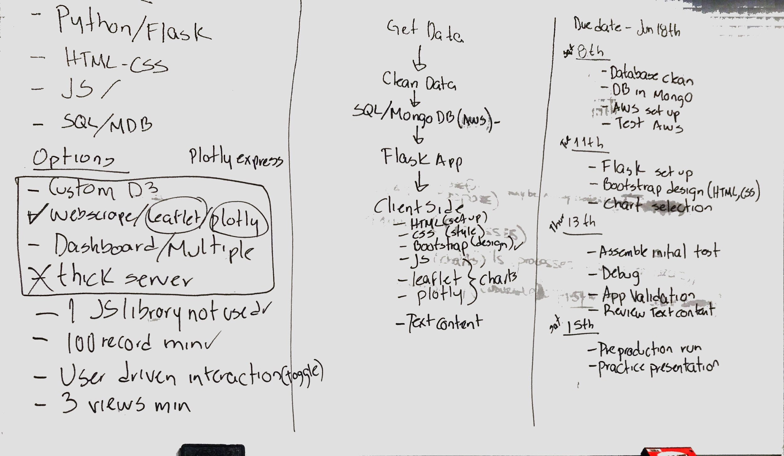
APPROACH
Identify theme & data sources
Assess data limitations
Define assumptions
Planning session
Identify visualizations & data tools
Identify & assign tasks
Establish milestones
Project work
Testing
Completion

Slide 4
TECHNOLOGIES
Back-end
Front-end
Data Retrieval & Cleaning
Python / Pandas
CSV
Data Storage
MySQL
Server
Flask
Client Side
HTML/CSS
Bootstrap
Javascript
D3
C3
Plotly
Leaflet

Slide 5
DATA
U.S. Gun Violence
U.S. Video Game Sales
Data Points
Gun Violence Archive
Nonprofit, public database
2,500+ sources, validated daily
239,000+ records of gun violence b/t 2013-2019, CSV format
VGChartz DB, video game sales tracking website, continental US
Data updated weekly
55,000 records b/t 1970-2019, CSV format
Drop null values (sales, ESRB rating, resulted in ~12,000 records
Guns
Date
Coordinates
# of victims
incident characteristics
Games
Year
NA Sales (in millions)
Genre
ESRB Rating

Slide 6
ASSUMPTIONS & LIMITATIONS
Guns
Games
4 or more shooting victims in single incident is considered a mass shooting (GVA)
No data before 2012
No ESRB ratings before 1994
“M” rating and “Shooter” genre considered violent
Sales by state not available

